Slide 1
Transforming between RDF and XML with XSPARQL
Nuno Lopes, Axel Polleres
Stefan.Decker@deri.org
http://www.StefanDecker.org/

Slide 2
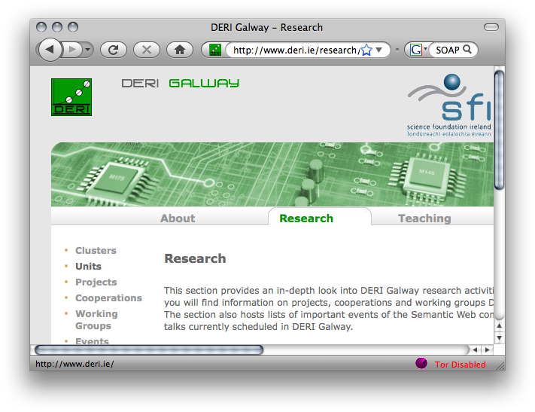
XSPARQL: Close the gap in the Web of Data
XSLT/XQuery
HTML
RSS
XSPARQL
<XML/>
SPARQL
SOAP/WSDL

Slide 3
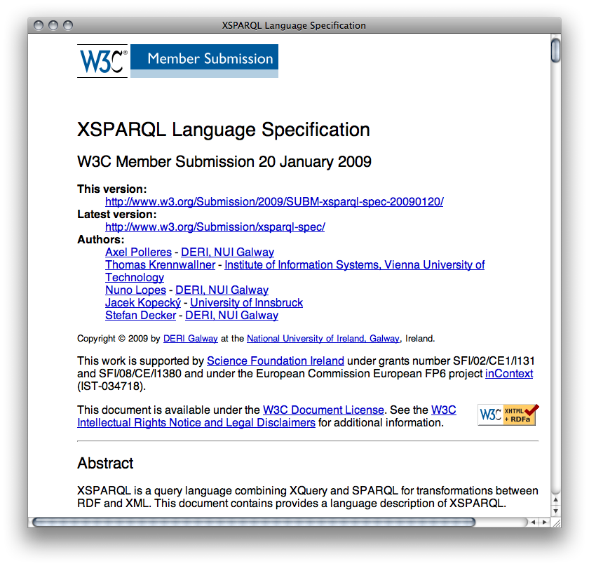
W3C Member Submission
http://www.w3.org/Submission/2009/01/
Supported by:
DERI
CTIC
INRIA
UIBK
Asemantics S.R.L
3

Slide 4
This talk
How can YOU use XSPARQL for handling XML and RDF data
What happened since 2009
What’s next in XSPARQL

Slide 5
A Sample Scenario…

Slide 6
Example: Favourite artists location
Display information about your favourite artists on a map
Last.fm knows what music you listen to, your most played artists, etc.
Using RDF allows to combine Last.fm info with other information on the web, e.g. location.
Show your top bands hometown in Google Maps.

Slide 7
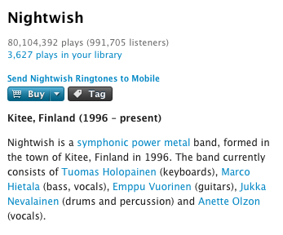
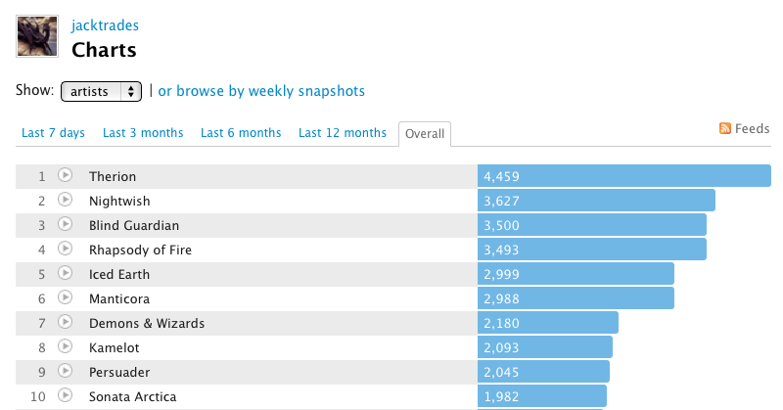
Example: Favourite artists location
How to implement the visualisation?
Get your favourite bands
Get the hometown of the bands
Create a KML file to be displayed in Google Maps
Last.fm shows your most listened bands
Last.fm is not so useful in this step
Last.fm API:
http://www.last.fm/api

Slide 8
Example: Favourite artists location
How to implement the visualisation?
Get your favourite bands
Get the hometown of the bands
Create a KML file to be displayed in Google Maps
XQuery
?
XQuery
SPARQL XML Res
SPARQL
XQuery

Slide 9
Transformation and Query Languages
XML Transformation Language
Syntax: XML
XML world
RDF world
XSLT
XQuery
XML Query Language
non-XML syntax
RDF/XML… ambiguous
Query Language for RDF
Pattern based
declarative
XPath
SPARQL
XPath is the common core
Mostly used to select nodes from an XML doc
SPARQL XML Result format

Slide 10
Background:
Existing languages
(XPath, XQuery and SPARQL)

Slide 11
Background: XML & XPath
<lfm status="ok">
<topartists type="overall">
<artist rank="1">
<name>Therion</name>
<playcount>4459</playcount>
<url>http://www.last.fm/music/Therion</url>
</artist>
<artist rank="2">
<name>Nightwish</name>
<playcount>3627</playcount>
<url>http://www.last.fm/music/Nightwish</url>
</artist>
</topartists>
</lfm>
Last.fm API format:
root element: “lfm”, then “topartists”
sequence of “artist”
Querying this document with XPath:
XPath steps:
/lfm
Selects the “lfm” root element
//artist
Selects all the “artist” elements
XPath Predicates:
//artist[@rank = 1]
Selects the “artist” with rank 1

Slide 12
Background: XQuery overview
iterate over sequences
assign values to variables
filter expressions
create XML elements
Query:
Retrieve information regarding a users' top artists from the
Last.fm API
let $doc := "http://ws.audioscrobbler.com/2.0/user.gettopartist"
for $artist in doc($doc)//artist
where $artist[@rank = 2] return <artistData>{$artist}</artistData>

Slide 13
Background: DBPedia RDF
RDF data from DBPedia describing artists:
Excerpt from: http://dbpedia.org/data/Nightwish.ttl
@prefix dbpprop: <http://dbpedia.org/property/> .
@prefix dbpedia: <http://dbpedia.org/resource/> .
@prefix dbpedia-owl: <http://dbpedia.org/ontology/> .
dbpedia:Nightwish dbpprop:origin "Kitee, Finland"@en ;
dbpedia-owl:hometown dbpedia:Kitee ,
dbpedia:Finland .

Slide 14
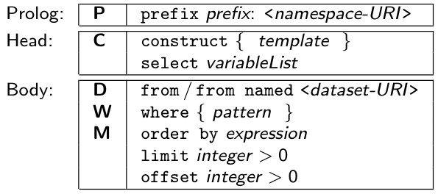
Background: SPARQL
Prefix declarations
construct RDF Graphs
SELECT
Data to be queried
pattern to be matched against data
Solution modifiers
prefix dbprop: <http://dbpedia.org/property/>
select $origin
from <http://dbpedia.org/resource/Nightwish>
where { $artist dbprop:origin $origin }
limit 1
Query:
Retrieve the origin of an artist from DBPedia
prefix dbprop: <http://dbpedia.org/property/>
prefix foaf: <http://xmlns.com/foaf/0.1/>
construct { $artist foaf:based_near $origin }
from <http://dbpedia.org/resource/Nightwish>
where { $artist dbprop:origin $origin }
limit 1

Slide 15
One language to bind them all:
XSPARQL

Slide 16
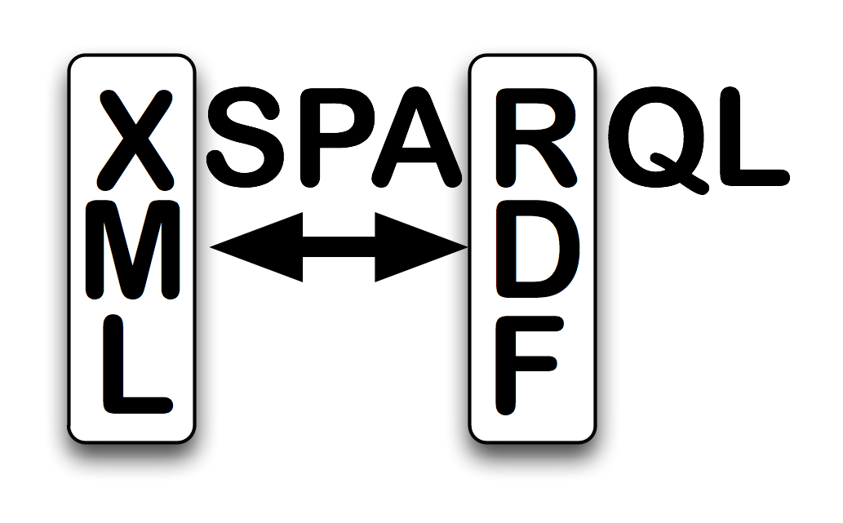
XSPARQL
Transformation language
Consume and generate XML and RDF
Syntactic extension of XQuery, ie.
XSPARQL = XQuery + SPARQL

Slide 17
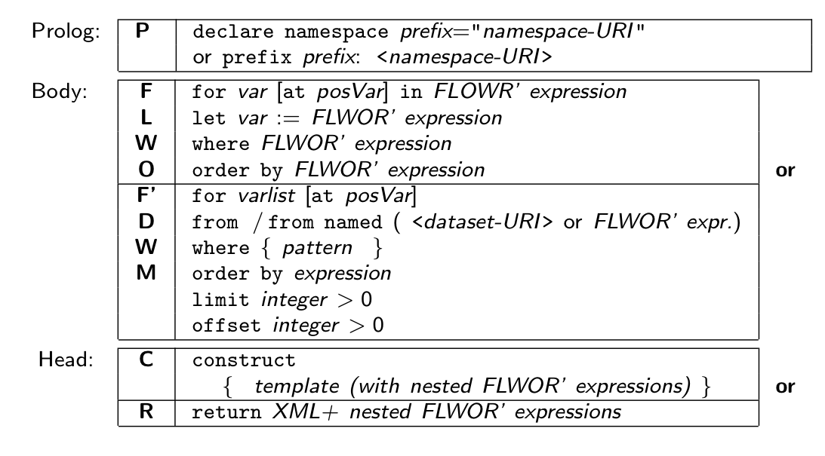
XSPARQL: Syntax overview (I)
Prefix declarations
Data Input (XML or RDF)
Data Output (XML or RDF)

Slide 18
XSPARQL Syntax overview (II)
XQuery or SPARQL prefix declarations
Any XQuery query
SPARQLFORClause represents a SPARQL query
construct allows to create RDF
18

Slide 19
Use case

Slide 20
XSPARQL: Convert XML to RDF
Query:
Convert Last.fm top artists of a user into RDF
prefix lastfm: <http://xsparql.deri.org/lastfm#>
let $doc := "http://ws.audioscrobbler.com/2.0/?method=user.gettopartists"
for $artist in doc($doc)//artist
where $artist[@rank < 6]
construct { [] lastfm:topArtist {$artist//name};
lastfm:artistRank {$artist//@rank} . }
Result:
@prefix lastfm: <http://xsparql.deri.org/lastfm#> .
[ lastfm:topArtist "Therion" ; lastfm:artistRank "1" ] .
[ lastfm:topArtist "Nightwish" ; lastfm:artistRank "2" ] .
[ lastfm:topArtist "Blind Guardian" ; lastfm:artistRank "3" ] .
[ lastfm:topArtist "Rhapsody of Fire" ; lastfm:artistRank "4" ] .
[ lastfm:topArtist "Iced Earth" ; lastfm:artistRank "5" ] .
construct generates valid Turtle RDF

Slide 21
Use case

Slide 22
XSPARQL: Integrate RDF sources
Query:
Retrieve the origin of an artist from DBPedia: Same as the SPARQL query
prefix dbprop: <http://dbpedia.org/property/>
prefix foaf: <http://xmlns.com/foaf/0.1/>
construct { $artist foaf:based_near $origin }
from <http://dbpedia.org/resource/Nightwish>
where { $artist dbprop:origin $origin }
Issue: determining the artist identifiers
DBPedia does not have the map coordinates

Slide 23
XSPARQL: Integrate RDF sources
Query:
Retrieve the origin of an artist from DBPedia including map coordinates
prefix wgs84_pos: <http://www.w3.org/2003/01/geo/wgs84_pos#>
prefix dbprop: <http://dbpedia.org/property/>
for * from <http://dbpedia.org/resource/Nightwish>
where { $artist dbprop:origin $origin }
return
let $hometown :=
fn:concat("http://api.geonames.org/search?type=rdf&q=",fn:encode-for-uri($origin))
for * from $hometown
where { [] wgs84_pos:lat $lat; wgs84_pos:long $long }
limit 1
construct { $artist wgs84_pos:lat $lat; wgs84_pos:long $long }
DBPedia does not have the map coordinates

Slide 24
Use case

Slide 25
Output: KML XML format
<kml xmlns="http://www.opengis.net/kml/2.2">
<Document>
<Placemark>
<name>Hometown of Nightwish</name>
<Point>
<coordinates>
30.15,62.1,0
</coordinates>
</Point>
</Placemark>
</Document>
</kml>
KML format:
root element: “kml”, then “Document”
sequence of “Placemark”
Each “Placemark” contains:
“Name” element
“Point” element with the “coordinates”

Slide 26
XSPARQL: Putting it all together
Query: Display top artists origin in a map
prefix dbprop: <http://dbpedia.org/property/>
<kml><Document>{
let $doc := "http://ws.audioscrobbler.com/2.0/?method=user.gettopartists”
for $artist in doc($doc)//artist
return let $artistName := fn:data($artist//name)
let $uri := fn:concat("http://dbpedia.org/resource/", $artistName)
for $origin from $uri
where { [] dbprop:origin $origin }
return
let $hometown := fn:concat("http://api.geonames.org/search?type=rdf&q=",
fn:encode-for-uri($origin))
for * from $hometown
where { [] wgs84_pos:lat $lat; wgs84_pos:long $long }
limit 1
return <Placemark>
<name>{fn:concat("Hometown of ", $artistName)}</name>
<Point><coordinates>{fn:concat($long, ",", $lat, ",0")}
</coordinates></Point>
</Placemark>
}</Document></kml>

Slide 27
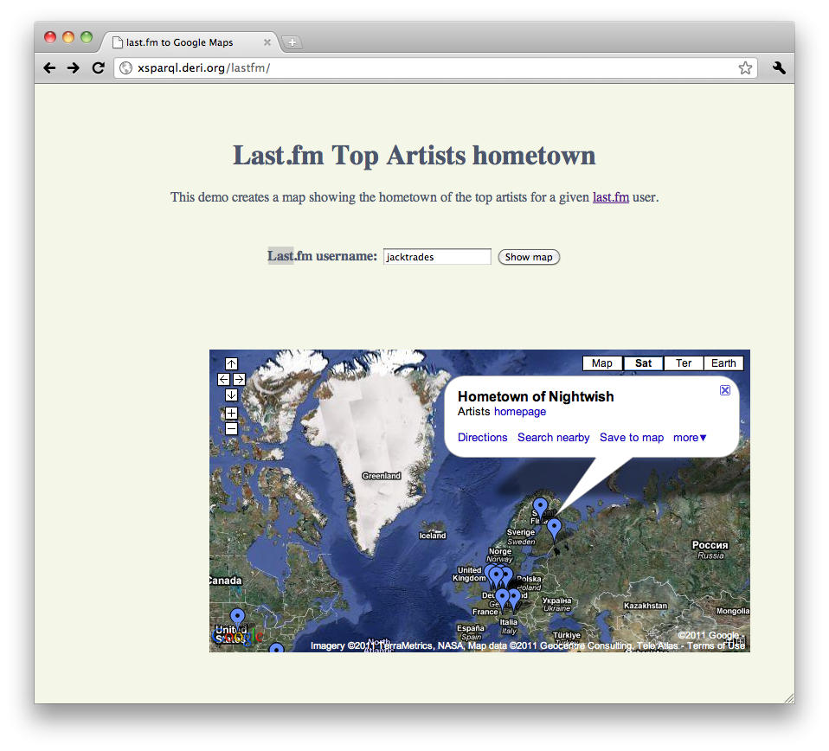
XSPARQL: Demo
http://xsparql.deri.org/lastfm

Slide 28
XSPARQL: more examples

Slide 29
XSPARQL: Convert FOAF to KML
RDF (FOAF) data representing your location … in different ways
Show this information in a Google Map embedded in your webpage
Demo at: http://xsparql.deri.org/foaf2kml/

Slide 30
XSPARQL: Convert FOAF to KML
http://nunolopes.org/foaf.rdf
<foaf:based_near>
<geo:Point>
<geo:lat>53.289881</geo:lat><geo:long>-9.073849</geo:long>
</geo:Point>
</foaf:based_near>
Display location in Google Maps based on your FOAF file
prefix foaf: <http://xmlns.com/foaf/0.1/>
prefix geo: <http://www.w3.org/2003/01/geo/wgs84_pos#>
<kml xmlns="http://www.opengis.net/kml/2.2">{
for $name $long $lat
from <http://nunolopes.org/foaf.rdf>
where { $person a foaf:Person; foaf:name $name;
foaf:based_near [ a geo:Point; geo:long $long;
geo:lat $lat ] }
return <Placemark>
<name>{fn:concat("Location of ", $name)}</name>
<Point>
<coordinates>{fn:concat($long, ",", $lat, ",0")}
</coordinates>
</Point>
</Placemark>
}</kml>

Slide 31
XSPARQL: Convert FOAF to KML Different location representation in different foaf files…
http://polleres.net/foaf.rdf
<foaf:based_near rdf:resource="http://dbpedia.org/resource/Galway"/>
prefix foaf: <http://xmlns.com/foaf/0.1/>
prefix georss: <http://www.georss.org/georss/>
<kml><Document>{
for * from <http://polleres.net/foaf.rdf>
where { $person a foaf:Person; foaf:name $name;
foaf:based_near $point. }
return for * from $point
where { $c georss:point $latLong }
return let $coordinates := fn:tokenize($latLong, " ")
let $lat1 := $coordinates[1]
let $long1 := $coordinates[2]
return <Placemark>
<name>{fn:concat("Location of ", $name)}</name>
<Point><coordinates>{fn:concat($long1, ",", $lat1, ",0")}
</coordinates></Point>
</Placemark>
}</Document></kml>
We can handle different representations of locations in the FOAF files

Slide 32
XSPARQL: Convert FOAF to KML you can cater for different representations in one query…
http://polleres.net/foaf.rdf
<foaf:based_near rdf:resource="http://dbpedia.org/resource/Galway"/>
Previous 2 queries can be easily combined into one… see:
http://xsparql.deri.org/foaf2kml/foaf2kml.xsparql
http://nunolopes.org/foaf.rdf
<foaf:based_near>
<geo:Point>
<geo:lat>53.289881</geo:lat><geo:long>-9.073849</geo:long>
</geo:Point>
</foaf:based_near>

Slide 33
Obtaining locations in RDF
Update or enhance your FOAF file with your current location based on a Google Maps search:
Find the location in Google Maps and get the result as KML
prefix foaf: <http://xmlns.com/foaf/0.1/>
prefix geo: <http://www.w3.org/2003/01/geo/wgs84_pos#>
prefix kml: <http://earth.google.com/kml/2.0>
let $loc := "Hilton San Francisco Union Square, San Francisco, CA"
for $place in doc(fn:concat("http://maps.google.com/?q=",
fn:encode-for-uri($loc),
”&num=1&output=kml"))
let $geo := fn:tokenize($place//kml:coordinates, ",")
construct { <nunolopes> foaf:based_near [ geo:long {$geo[1]};
geo:lat {$geo[2]} ] }
Result:
@prefix geo: <http://www.w3.org/2003/01/geo/wgs84_pos#> .
@prefix foaf: <http://xmlns.com/foaf/0.1/> .
@prefix kml: <http://earth.google.com/kml/2.0> .
<nunolopes> foaf:based_near [ geo:long "-122.411116" ;
geo:lat "37.786000" ] .

Slide 34
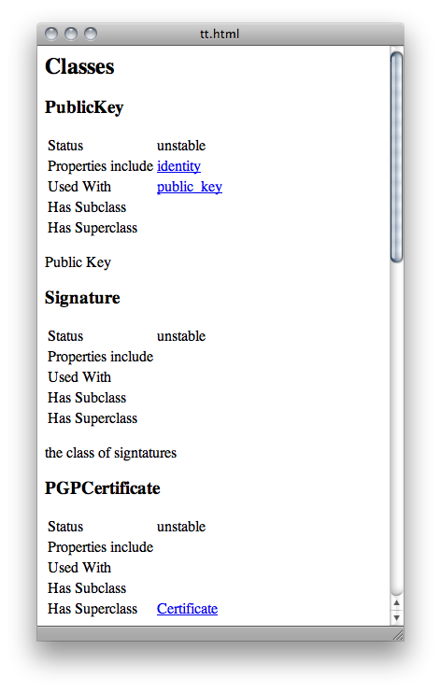
Ontology Documentation in HTML
Given an ontology you can generate an XHTML describing it…
<html><head></head>
<body>
<h2>Classes</h2>{
for * from <http://www.w3.org/ns/auth/cert.n3>
where { $class a owl:Class; rdfs:label $label; rdfs:comment $comment .
} return <div name="{$label}"><h3>{$label}</h3>
<p>{$comment}</p>
</div>}
<h2>Properties</h2>{
for * from <http://www.w3.org/ns/auth/cert.n3>
where { $prop a rdf:Property; rdfs:label $lbl; rdfs:comment $commnt .
} return <div name="{$lbl}"><h3>{$lbl}</h3>
<p>{$commnt}</p>
</div>}
</body></html>
Use case and query by Henry Story

Slide 35
XSPARQL vs. SPARQL for “pure RDF” queries

Slide 36
Extending SPARQL1.0: Computing values
Computing values is not possible in SPARQL 1.0:
prefix foaf: <http://xmlns.com/foaf/0.1/>
prefix geo: <http://www.w3.org/2003/01/geo/wgs84_pos#>
prefix : <http://xsparql.deri.org/geo#>
construct { $person :latLong $lat; :latLong $long }
from <http://nunolopes.org/foaf.rdf>
where { $person a foaf:Person; foaf:name $name;
foaf:based_near [ geo:long $long;
geo:lat $lat ] }
While XSPARQL allows to use all the XPath functions:
prefix foaf: <http://xmlns.com/foaf/0.1/>
prefix geo: <http://www.w3.org/2003/01/geo/wgs84_pos#>
prefix : <http://xsparql.deri.org/geo#>
construct { $person :latLong {fn:concat($lat, " ”, $long }}
from <http://nunolopes.org/foaf.rdf>
where { $person a foaf:Person; foaf:name $name;
foaf:based_near [ geo:long $long;
geo:lat $lat ] }
Note: SPARQL1.1 allow that (BIND/LET), see Andy’s tutorial (yesterday)!

Slide 37
Federated Queries in SPARQL1.1
Find which persons in DBPedia have the same birthday as Axel (foaf-file):
SPARQL 1.1 has new feature SERVICE to query remote endpoints
PREFIX dbpedia2: <http://dbpedia.org/property/>
PREFIX foaf: <http://xmlns.com/foaf/0.1/>
SELECT ?N ?MyB
FROM <http://polleres.net/foaf.rdf>
{ [ foaf:birthday ?MyB ].
SERVICE <http://dbpedia.org/sparql> { SELECT ?N WHERE {
[ dbpedia2:born ?B; foaf:name ?N ]. FILTER ( Regex(Str(?B),str(?MyB)) ) } }
}
PREFIX dbpedia2: <http://dbpedia.org/property/>
PREFIX foaf: <http://xmlns.com/foaf/0.1/>
SELECT ?N ?MyB
FROM <http://polleres.net/foaf.rdf>
{ [ foaf:birthday ?MyB ].
SERVICE <http://dbpedia.org/sparql> { SELECT ?N WHERE {
[ dbpedia2:born ?B; foaf:name ?N ]. FILTER ( Regex(str(?B),str(?MyB)) ) } }
}
Doesn’t work!!! ?MyB unbound in SERVICE query

Slide 38
Federated Queries in SPARQL1.1
Find which persons in DBPedia have the same birthday as Axel (foaf-file):
SPARQL 1.1 has new feature SERVICE to query remote endpoints
PREFIX dbpedia2: <http://dbpedia.org/property/>
PREFIX foaf: <http://xmlns.com/foaf/0.1/>
SELECT ?N ?MyB
FROM <http://polleres.net/foaf.rdf>
{ [ foaf:birthday ?MyB ].
SERVICE <http://dbpedia.org/sparql> { SELECT ?N WHERE {
[ dbpedia2:born ?B; foaf:name ?N ]. FILTER ( Regex(Str(?B),str(?MyB)) ) } }
}
PREFIX dbpedia2: <http://dbpedia.org/property/>
PREFIX foaf: <http://xmlns.com/foaf/0.1/>
SELECT ?N ?MyB
FROM <http://polleres.net/foaf.rdf>
{ [ foaf:birthday ?MyB ].
SERVICE <http://dbpedia.org/sparql> { SELECT ?N WHERE {
[ dbpedia2:born ?B; foaf:name ?N ]. } }
FILTER ( Regex(Str(?B),str(?MyB)) )
}
Doesn’t work either in practice ☹ as SERVICE endpoint only returns limited results…

Slide 39
Federated Queries
Find which persons in DBPedia have the same birthday as Axel (foaf-file):
In XSPARQL:
prefix dbprop: <http://dbpedia.org/property/>
prefix foaf: <http://xmlns.com/foaf/0.1/>
prefix : <http://xsparql.deri.org/bday#>
let $MyB := for * from <http://polleres.net/foaf.rdf>
where { [ foaf:birthday $B ]. }
return $B
for * from <http://dbpedia.org/> endpoint <http://dbpedia.org/sparql>
where { [ dbprop:born $B; foaf:name $N ].
filter ( regex(str($B),str($MyB)) ) }
construct { :axel :sameBirthDayAs $N }
Specifies the endpoint to perform the query, similar to SERVICE in SPARQL1.1
Works! In XSPARQL bound values (?MyDB) are injected into the SPARQL subquery
→ More direct control over “query execution plan”

Slide 40
XSPARQL: next steps

Slide 41
Next Steps: Relational databases
Integrating SQL in XSPARQL
XSPARQL + SQL (subset)
Transform relational data into XML or RDF
RDB2RDF
Query:
Convert top artists of a user into RDF. Data stored in an RDB relation “topArtists”.
prefix lastfm: <http://xsparql.deri.org/lastfm#>
for topArtists.artist as $artist, topArtists.rank as $rank
from topArtists
where topArtists.rank < 6
construct { [] lastfm:topArtist $artist; lastfm:artistRank $rank . }
Prototype coming out soon!

Slide 42
New features & Next Steps
New features we didn’t talk about:
Assign Graphs to variables
Dataset-scoping in nested Queries
Further Next steps:
Optimisations
SPARQL 1.1
JSON
Most Web APIS are exposing data as JSON

Slide 43
Conclusions
XSPARQL can easily integrate XML and RDF sources
Beyond the expressiveness of SPARQL 1.0 (and partially also SPARQL 1.1)
More features on the way (RDB, JSON)
Check our webpage for XSPARQLer engine (BSD licence) and demos at
http://xsparql.deri.org/

Slide 44
XSPARQL: further details

Slide 45
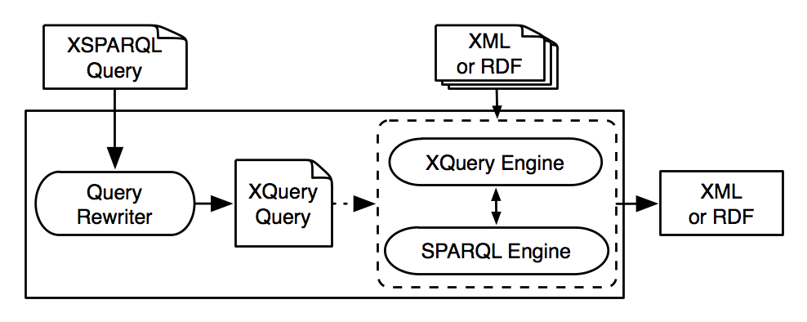
Implementation
Each XSPARQL query is translated into an XQuery
SPARQLForClauses are translated into SPARQL SELECT clauses
Uses off the shelf components:
XQuery engine: Saxon
SPARQL engine: Jena / ARQ

